Slide 1
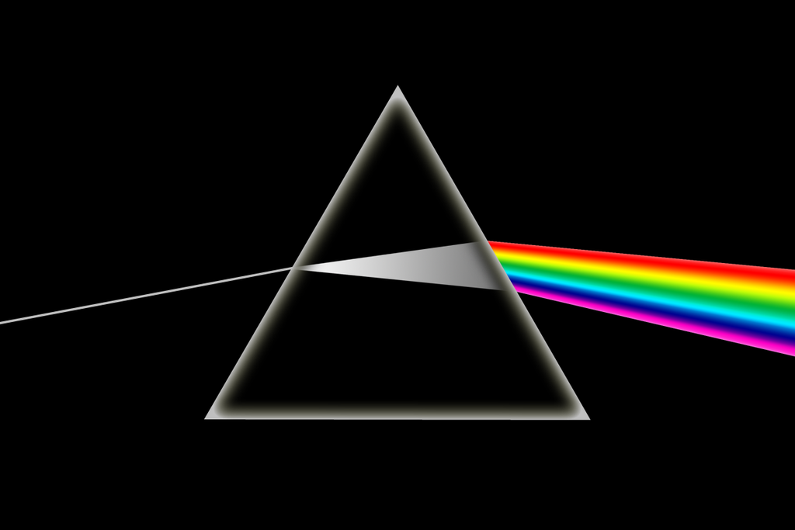
Dispersion and Measures of Dispersion

Slide 2
What is Dispersion in Statistics?
Dispersion is the state of getting dispersed or spread. Statistical dispersion means the extent to which numerical data is likely to vary about an average value. In other words, dispersion helps to understand the distribution of the data.

Slide 3
Measures of Dispersion
In statistics, the measures of dispersion help to interpret the variability of data i.e. to know how much homogenous or heterogeneous the data is. In simple terms, it shows how squeezed or scattered the variable is.

Slide 4
Types of Measures of Dispersion
There are two main types of dispersion methods in statistics which are:
Absolute Measure of Dispersion
Relative Measure of Dispersion

Slide 5
Absolute Measure of Dispersion
An absolute measure of dispersion contains the same unit as the original data set. The absolute dispersion method expresses the variations in terms of the average of deviations of observations like standard or means deviations. It includes range, standard deviation, quartile deviation, etc.
The types of absolute measures of dispersion are:
Range: It is simply the difference between the maximum value and the minimum value given in a data set. Example: 1, 3,5, 6, 7 => Range = 7 -1= 6
Variance: Deduct the mean from each data in the set, square each of them and add each square and finally divide them by the total no of values in the data set to get the variance. Variance (σ²) = ∑(X−μ)²/N
Standard Deviation: The square root of the variance is known as the standard deviation i.e. S.D. = √σ.
Quartiles and Quartile Deviation: The quartiles are values that divide a list of numbers into quarters. The quartile deviation is half of the distance between the third and the first quartile.
Mean and Mean Deviation: The average of numbers is known as the mean and the arithmetic mean of the absolute deviations of the observations from a measure of central tendency is known as the mean deviation (also called mean absolute deviation).

Slide 6
Relative Measure of Dispersion
The relative measures of dispersion are used to compare the distribution of two or more data sets. This measure compares values without units. Common relative dispersion methods include:
Co-efficient of Range
Co-efficient of Variation
Co-efficient of Standard Deviation
Co-efficient of Quartile Deviation
Co-efficient of Mean Deviation

Slide 7
Co-efficient of Dispersion
The coefficients of dispersion are calculated (along with the measure of dispersion) when two series are compared, that differ widely in their averages. The dispersion coefficient is also used when two series with different measurement units are compared. It is denoted as C.D.
The common coefficients of dispersion are:
The coefficients of dispersion are calculated (along with the measure of dispersion) when two series are compared, that differ widely in their averages. The dispersion coefficient is also used when two series with different measurement units are compared. It is denoted as C.D.
The common coefficients of dispersion are:
C.D. in terms of | Coefficient of dispersion
Range | C.D. = (X_{max} – X_{min}) ⁄ (X_{max} + X_{min})
Quartile Deviation | C.D. = (Q3 – Q1) ⁄ (Q3 + Q1)
Standard Deviation (S.D.) | C.D. = S.D. ⁄ Mean
Mean Deviation | C.D. = Mean deviation/Average

Slide 8
THANKYOU

